Slide 1
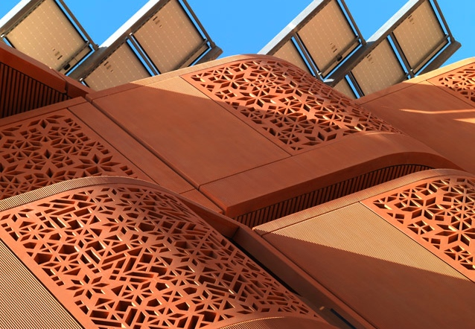

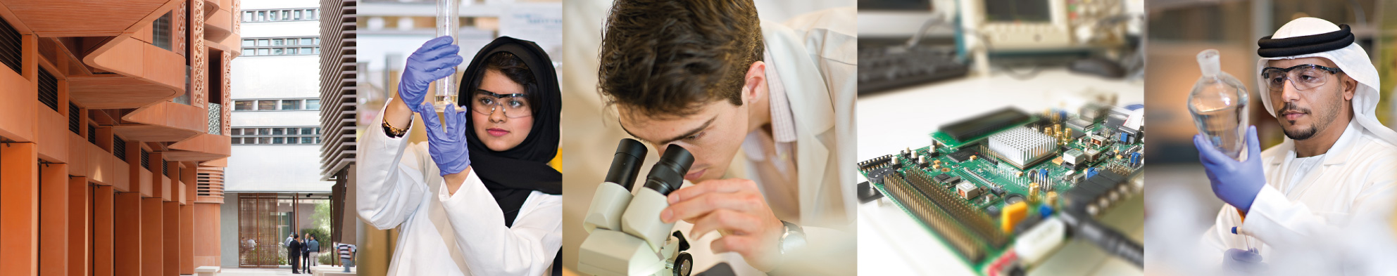
Solar Resource & Solar Technologies UCC501 – Part 1
Dr. Nicolas CALVET
Assistant Professor
Thermal Energy Storage (TES) Group Leader
iEnergy Center
Department of Mechanical and Materials Engineering (MME)

Slide 2

Solar Resource
Solar Resource
Dr. Nicolas CALVET

Slide 3


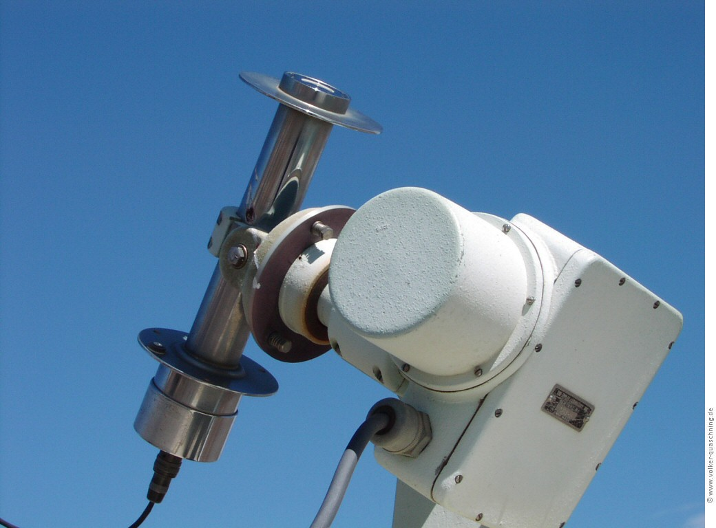
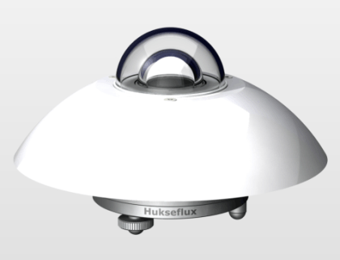
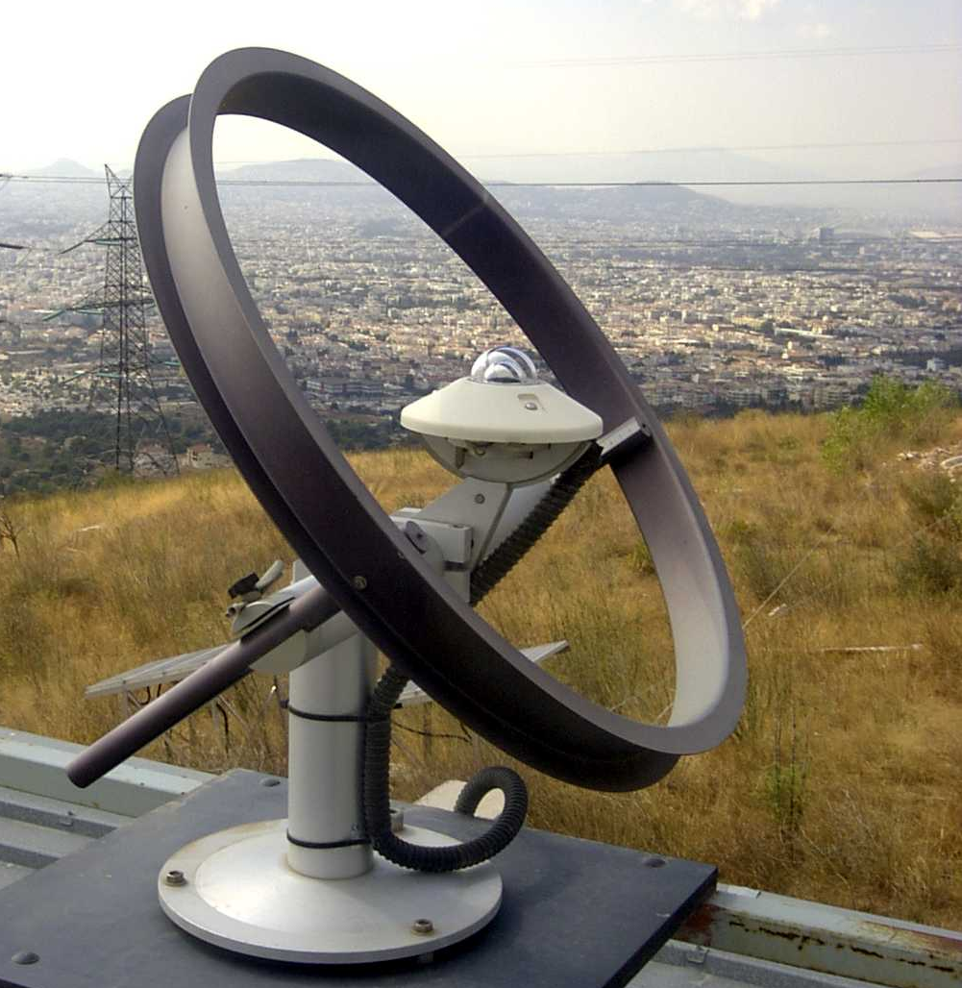
Solar Resource
Available Solar Radiation
Beam-solar radiation
Or Direct radiation
Diffuse solar radiation
Reflected solar radiation
Pyrheliometer
Pyranometer
Shaded Pyranometer
Dr. Nicolas CALVET

Slide 4
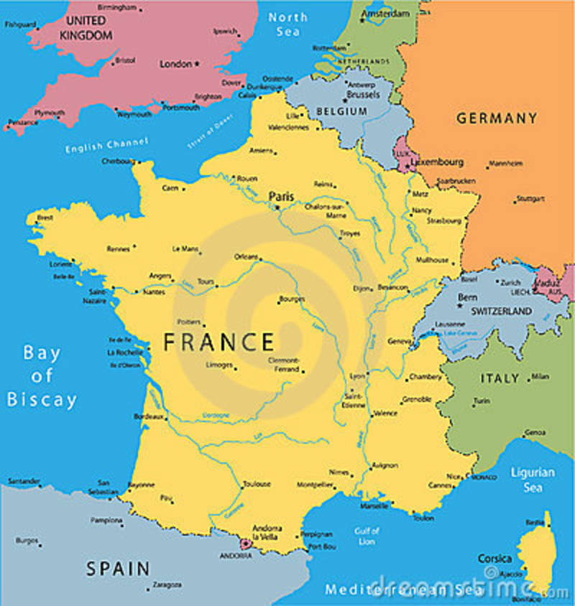

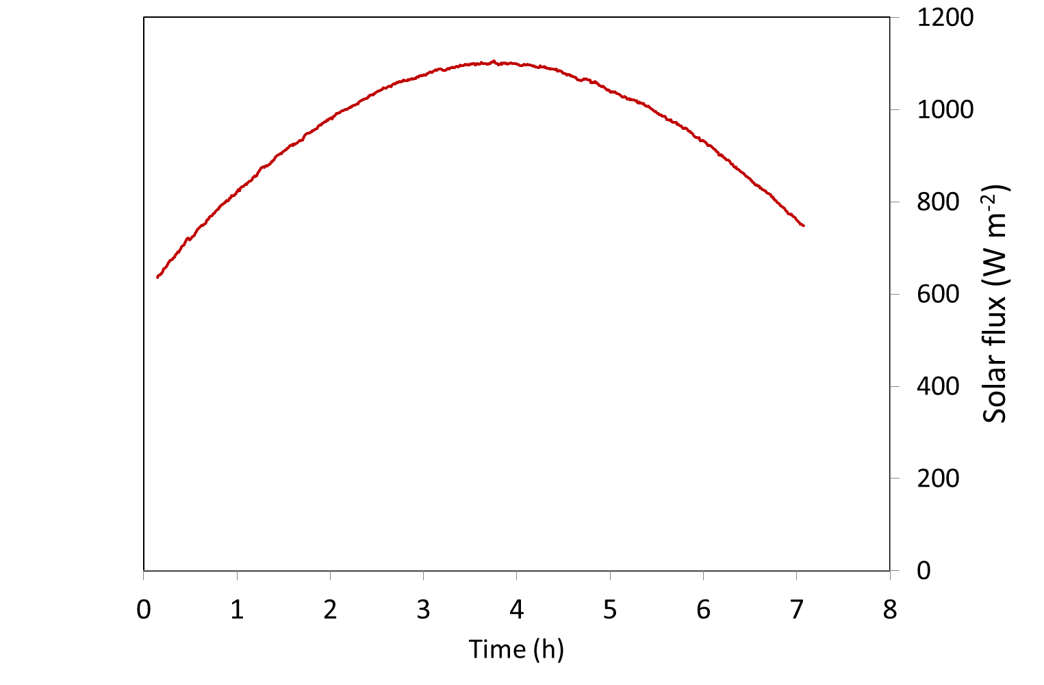
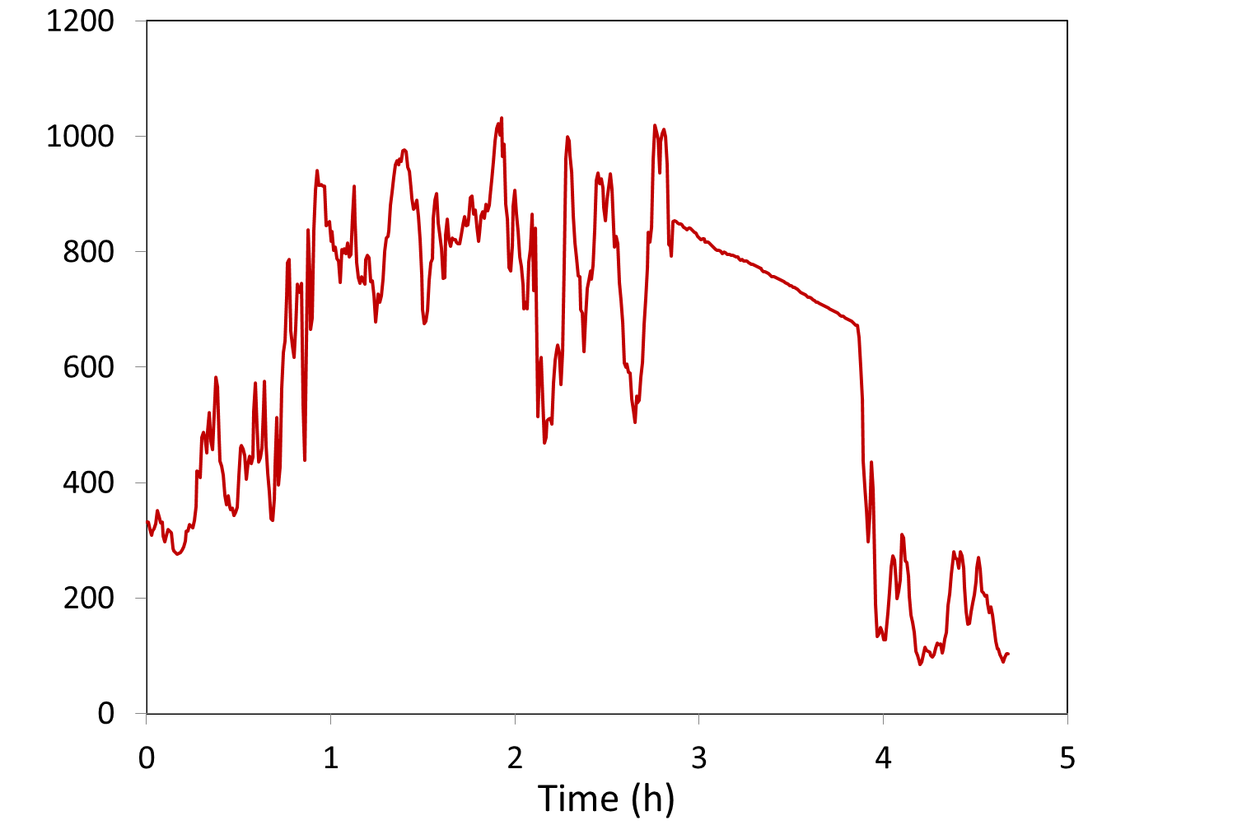
Solar Resource
Measured in south of France
Solar radiation on a clear day
Solar radiation on a cloudy day
Dr. Nicolas CALVET

Slide 5
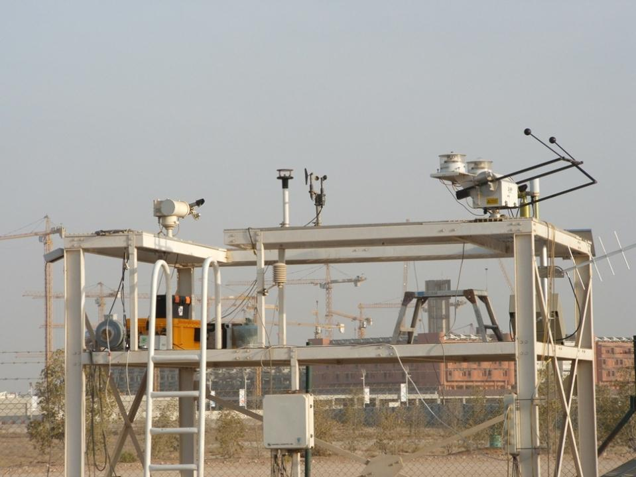
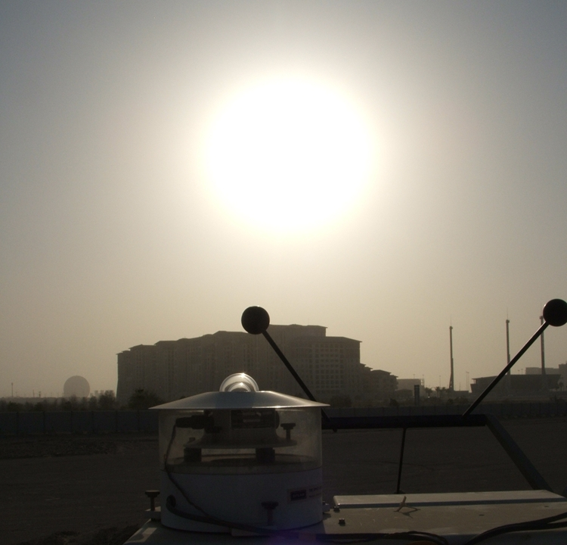
Solar Resource
Solar Irradiometer Platform (SIP)
Source: Dr. Peter Armstrong
Dr. Nicolas CALVET

Slide 6
Solar Resource
Dr. Nicolas CALVET

Slide 7
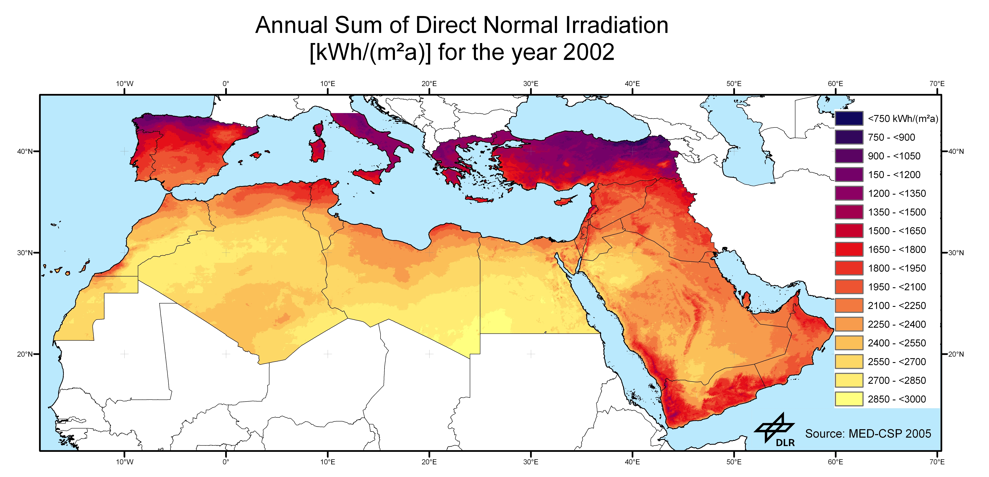
Solar Resource
In U.A.E.: 1950 – 2400 KWh/m²y
Dr. Nicolas CALVET

Slide 8
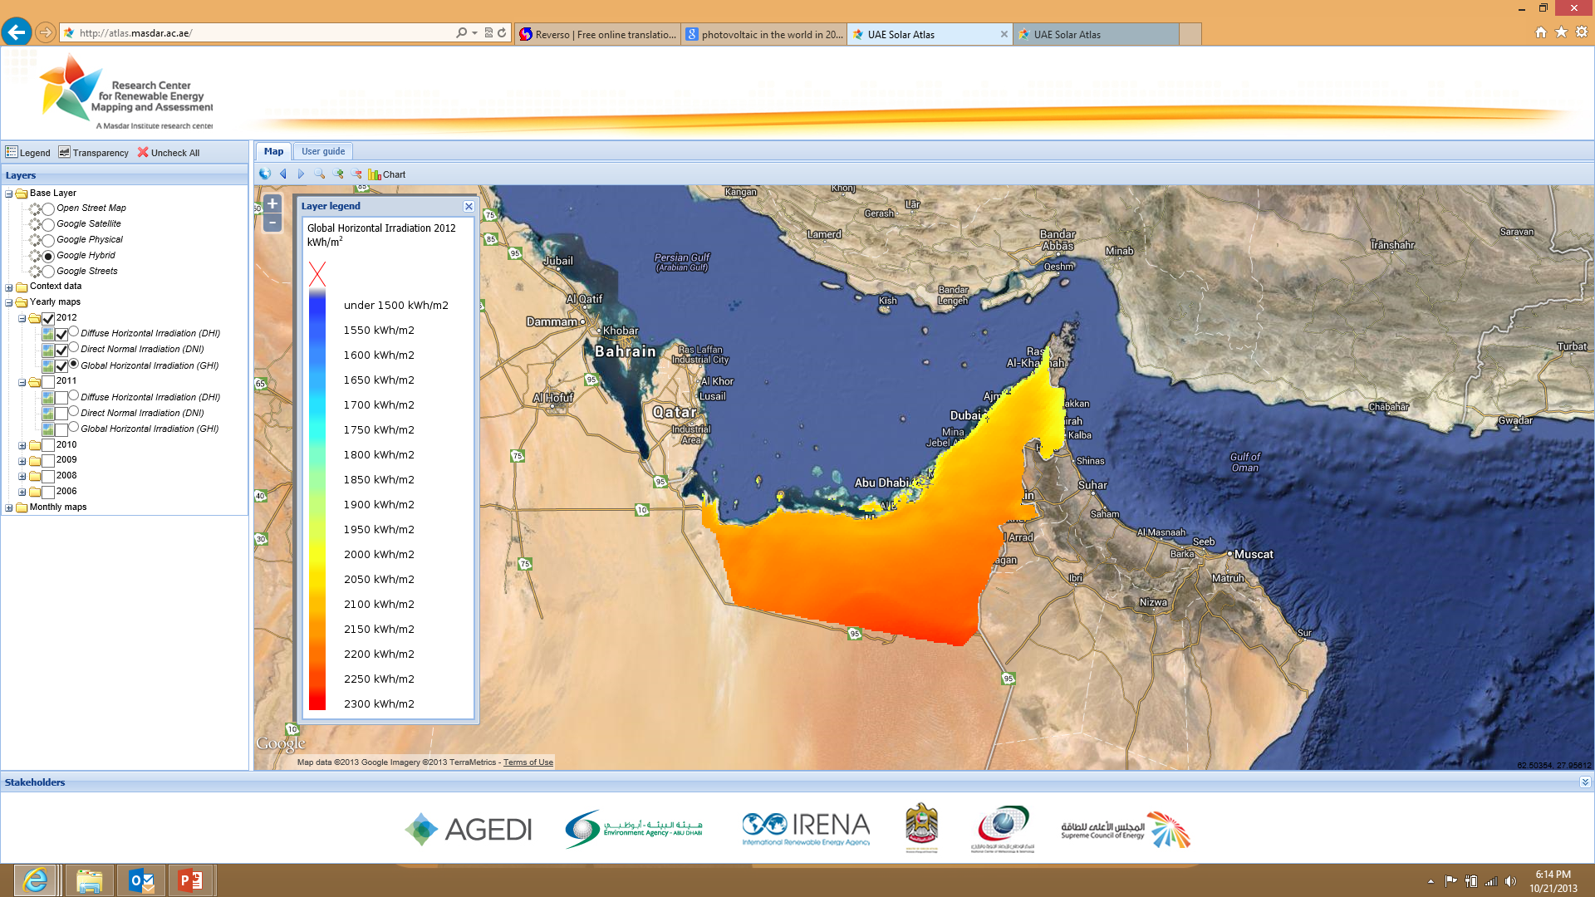
Solar Resource
http://solaratlas.masdar.ac.ae/
Dr. Nicolas CALVET

Slide 9
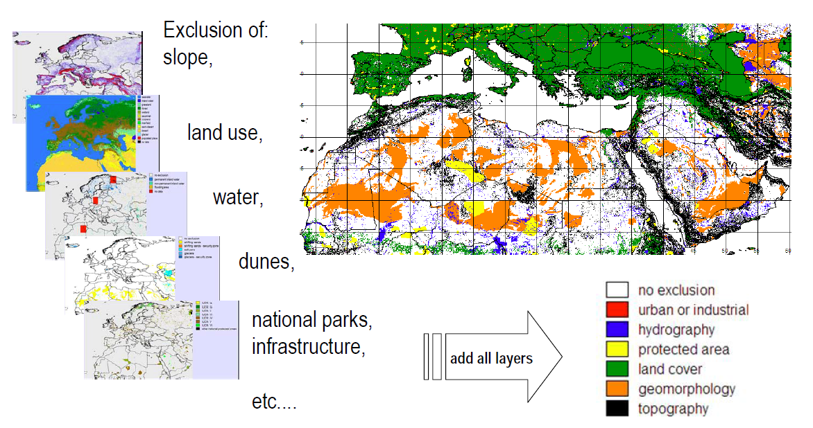
Solar Resource
Source: Franz Trieb, DLR, SolarPaces 2009, Berlin Germany
Dr. Nicolas CALVET

Slide 10
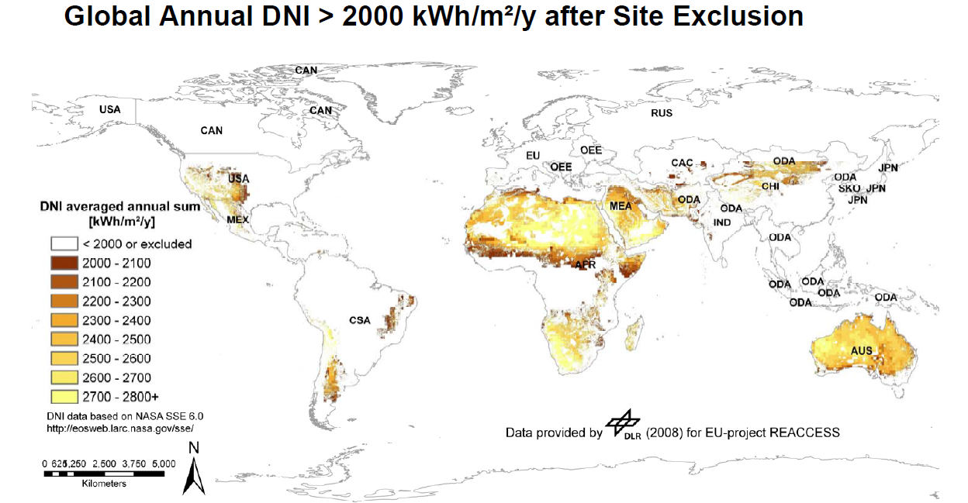
Solar Resource
Source: Franz Trieb, DLR, SolarPaces 2009, Berlin Germany
Dr. Nicolas CALVET

Slide 11
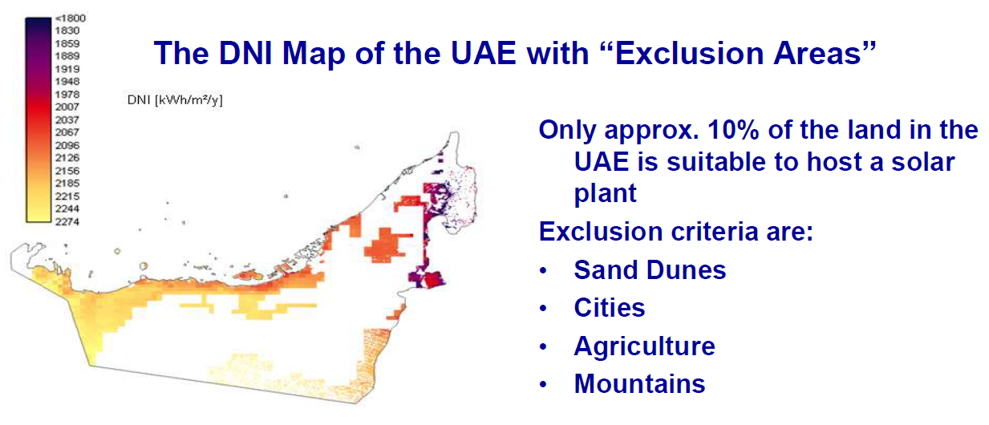
Solar Resource
Source: Dr. O. Goebel
Dr. Nicolas CALVET

Slide 12
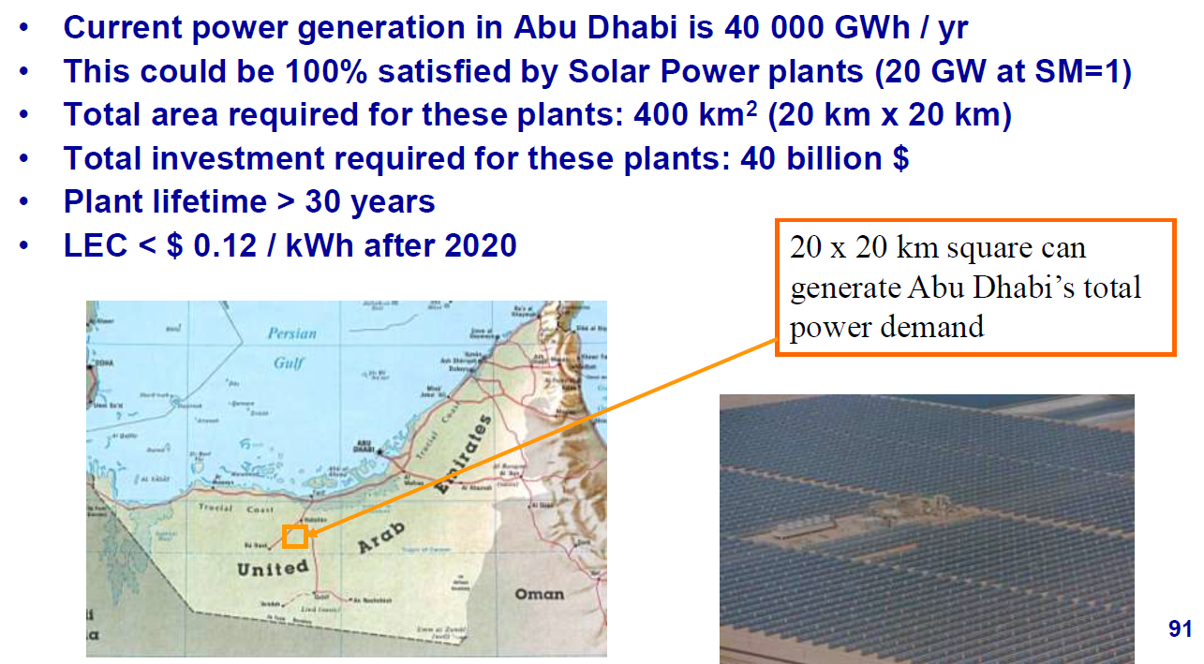
Solar Resource
Solar Power Potential in Abu Dhabi
Source: Dr. O. Goebel
Dr. Nicolas CALVET

Slide 13
Solar Technologies
Solar Technologies
Dr. Nicolas CALVET

Slide 14
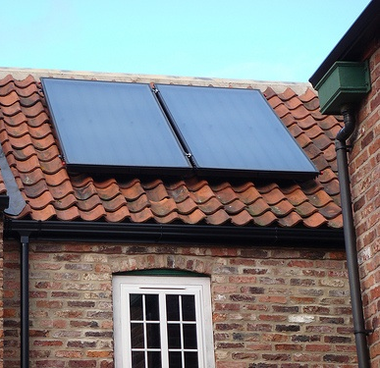
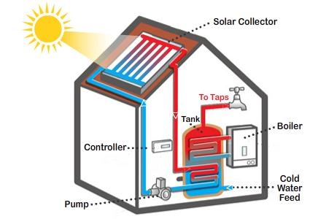
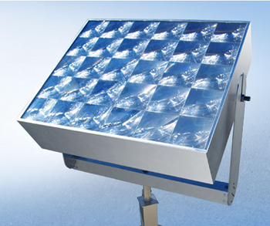
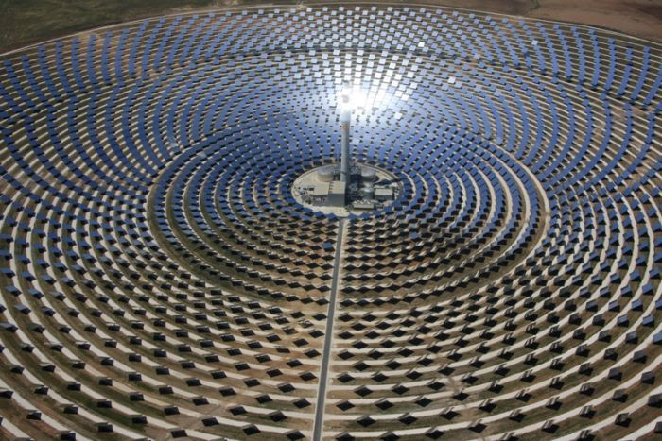
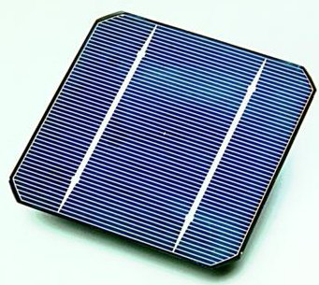
Solar Technologies
T (°C)
Ambient T
200 3000
1. Non-Concentrated Solar Technologies | 2. Concentrated Solar Technologies
1.1. Photovoltaic 1.2. Solar Thermal | 2.1. Concentrated Photovoltaic (CPV) 2.2. Concentrated Solar Power (CSP)
Dr. Nicolas CALVET

Slide 15
Non-Concentrated Technologies
Solar Technologies
Dr. Nicolas CALVET

Slide 16
1. Non-concentrated Solar Technologies
Solar Technologies
1.1. Photovoltaic (PV)
Si atom
4e⁻ in the valence band
PV effect: Alexandre Edmund Becquerel in 1839
PV cell: Bells Labs in 1954
Covalent bond
Conduction band
Energy
Si crystal
Valence band
Dr. Nicolas CALVET

Slide 17
1. Non-concentrated Solar Technologies
Solar Technologies
1.1. Photovoltaic (PV)
PV effect: Alexandre Edmund Becquerel in 1839
PV cell: Bells Labs in 1954
Conduction band
Conduction band
Energy
Valence band
Valence band
Dr. Nicolas CALVET

Slide 18
1. Non-concentrated Solar Technologies
Solar Technologies
1.1. Photovoltaic (PV)
Doping with impurities
Phosphorus
Bore
Si crystal
N - Type
P - Type
Dr. Nicolas CALVET

Slide 19
1. Non-concentrated Solar Technologies
Solar Technologies
1.1. Photovoltaic (PV)
+
-
P-N Junction
N - Type
P - Type
Dr. Nicolas CALVET

Slide 20
1. Non-concentrated Solar Technologies
Solar Technologies
1.1. Photovoltaic (PV)
Conduction band
Conduction band
Energy
Electric field
+
-
Valence band
Valence band
More details? watch this video on You Tube “The Power of the Sun - The Science of the Silicon Solar Cell”: http://www.youtube.com/watch?v=u0hckM8TKY0
Dr. Nicolas CALVET

Slide 21
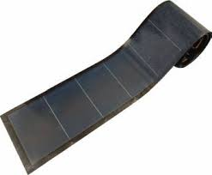
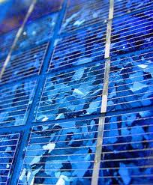
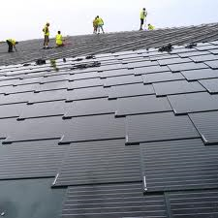
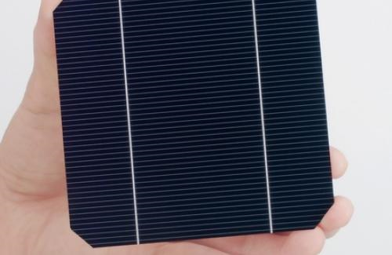
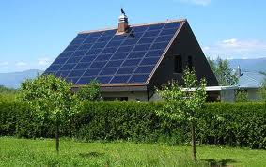
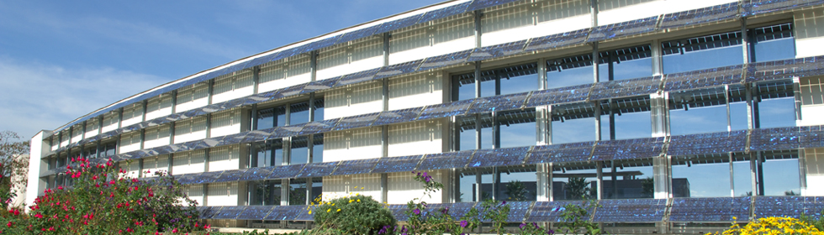
1. Non-concentrated Solar Technologies
1.1. Photovoltaic (PV) – Solar Cells & Solar panels
Thin film
Solar tiles
Monocrystalline
Polycrystalline
Dr. Nicolas CALVET

Slide 22
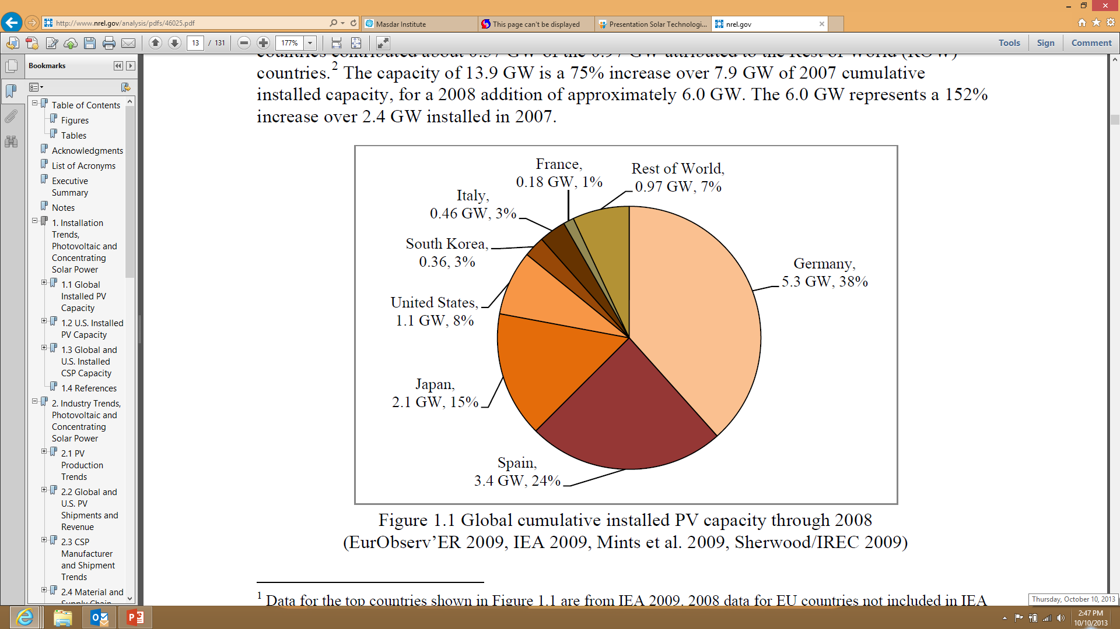
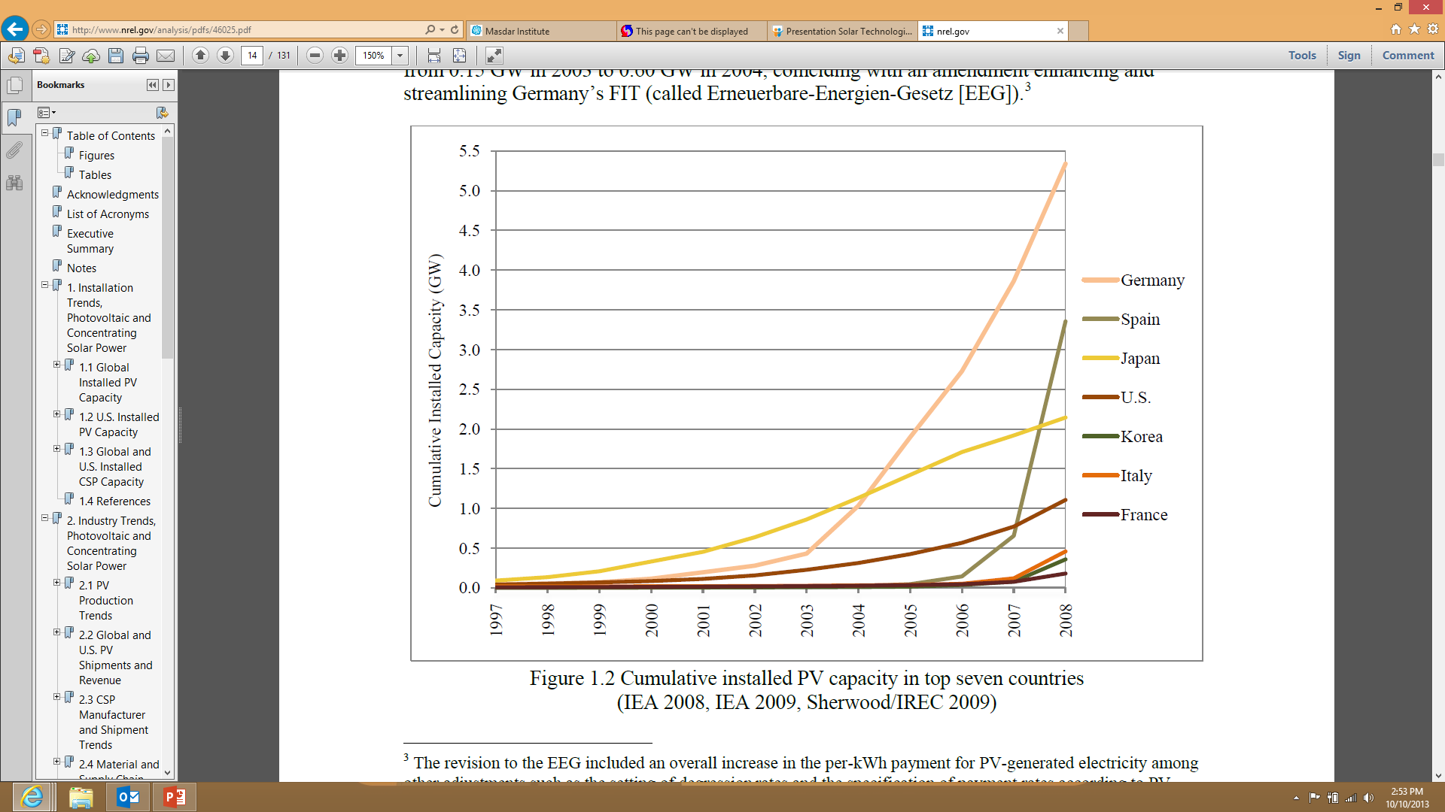
1. Non-concentrated Solar Technologies
Solar Technologies
1.1. Photovoltaic in the world
Dr. Nicolas CALVET

Slide 23
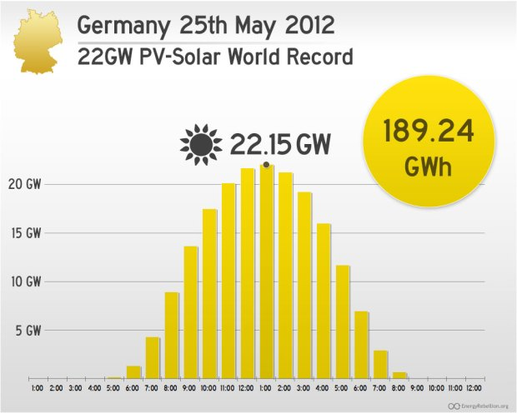
1. Non-concentrated Solar Technologies
Solar Technologies
1.1. Photovoltaic in the world
30 % of all electricity demand
Dr. Nicolas CALVET

Slide 24
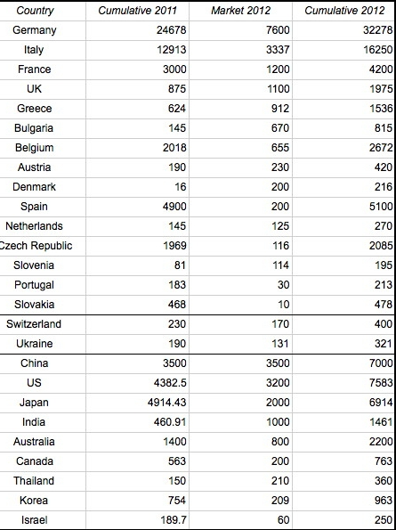
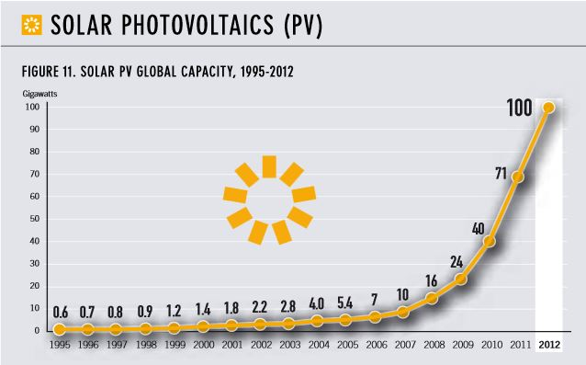
1. Non-concentrated Solar Technologies
Solar Technologies
MW_{e}
1.1. Photovoltaic in the world
Source: Web
1. Germany (32.2 GW); 2. Italy (16.2 GW); 3. USA (7.5 GW); 4. China (7 GW); 5. Japan (6.9 GW)
Dr. Nicolas CALVET

Slide 25
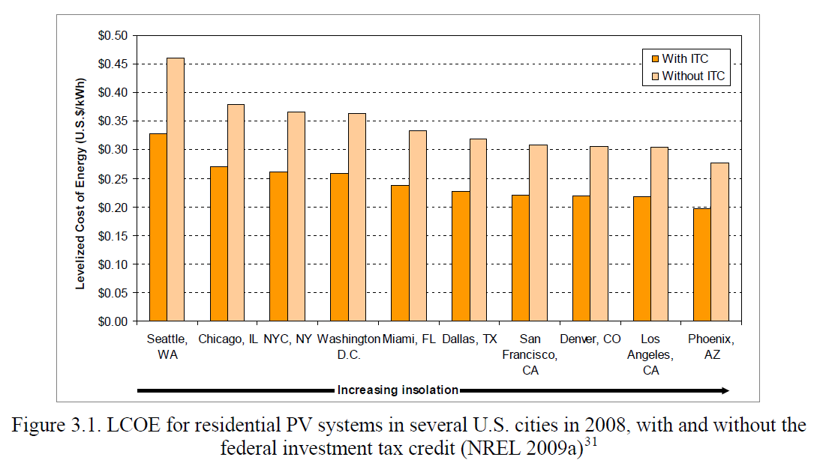
1. Non-concentrated Solar Technologies
Solar Technologies
1.1. Photovoltaic in the world - Levelized Cost Of Energy (LCOE) =
investment + Fuel + O&M costs
Net electric output
Dr. Nicolas CALVET

Slide 26
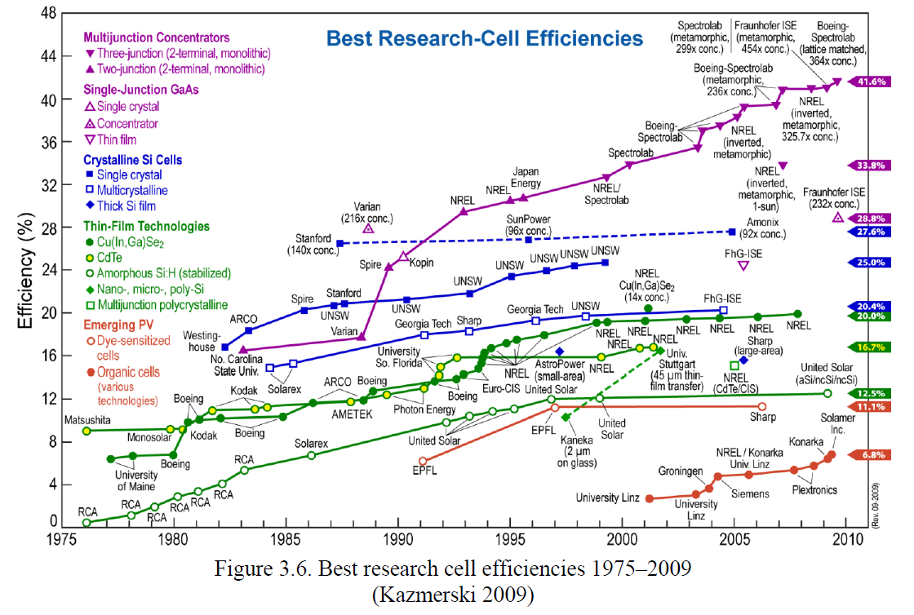
1. Non-concentrated Solar Technologies
Solar Technologies
1.1. Photovoltaic in the world – Cell Efficiency
World Record
2013
Fraunhofer ISE
CEA Leti
Soitec
Helmotz Centre
44.7 %!!!
Dr. Nicolas CALVET

Slide 27
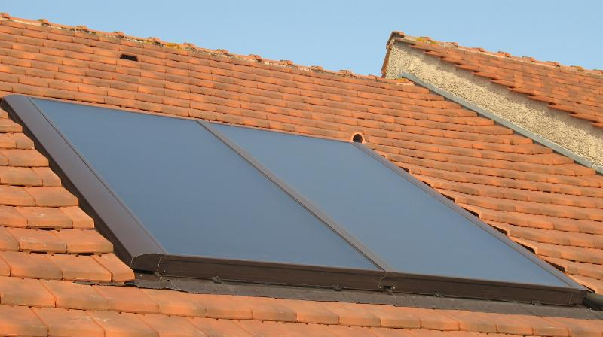
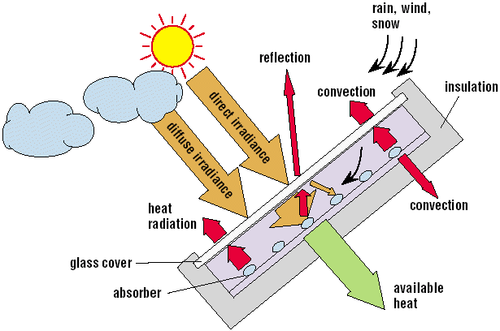
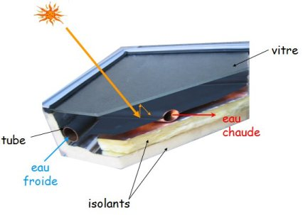
1. Non-concentrated Solar Technologies
Solar Technologies
1.1. Solar Thermal
1.1.1. Solar Domestic Hot Water (SDHW) Systems: Flat Panels
Dr. Nicolas CALVET

Slide 28
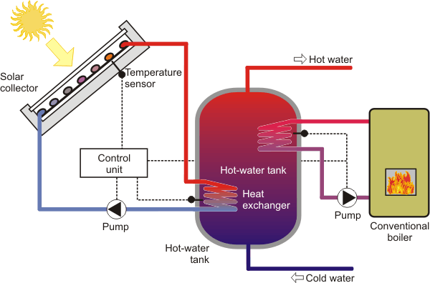
1. Non-concentrated Solar Technologies
Solar Technologies
1.1. Solar Thermal
1.1.1. Solar Domestic Hot Water (SDHW) Systems: Flat Panels
glass
Or electric resistance
Hot water
Cold water
Insulation
Dr. Nicolas CALVET

Slide 29
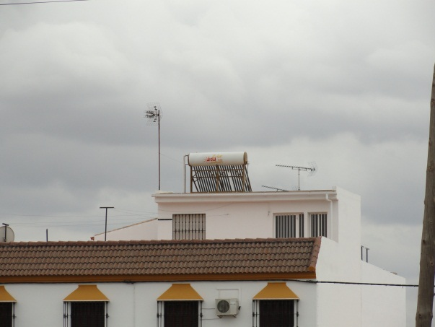
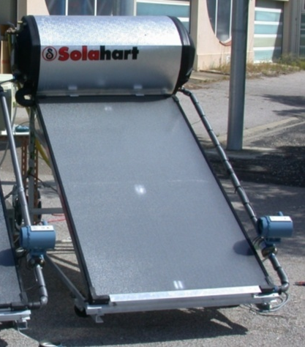
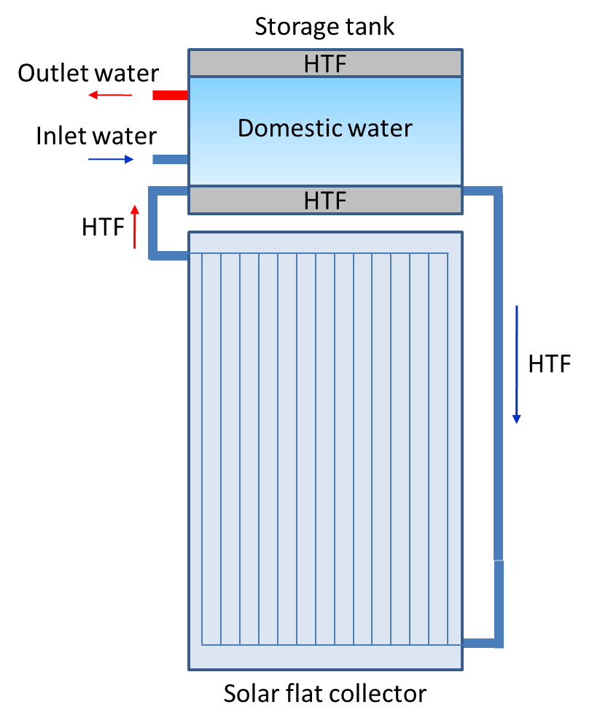
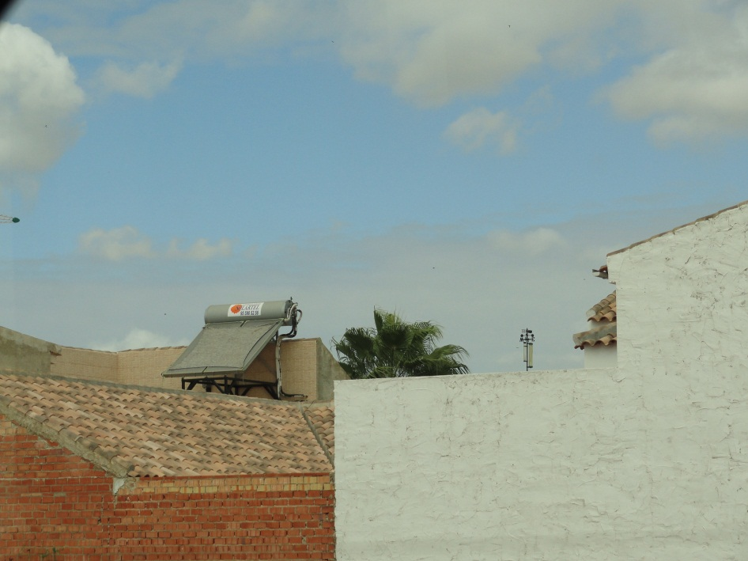
1. Non-concentrated Solar Technologies
Solar Technologies
1.1. Solar Thermal
1.1.2. SDHW Systems: Thermosiphon System
Thermosiphons in Seville
PROMES laboratory´s prototypes
Dr. Nicolas CALVET

Slide 30
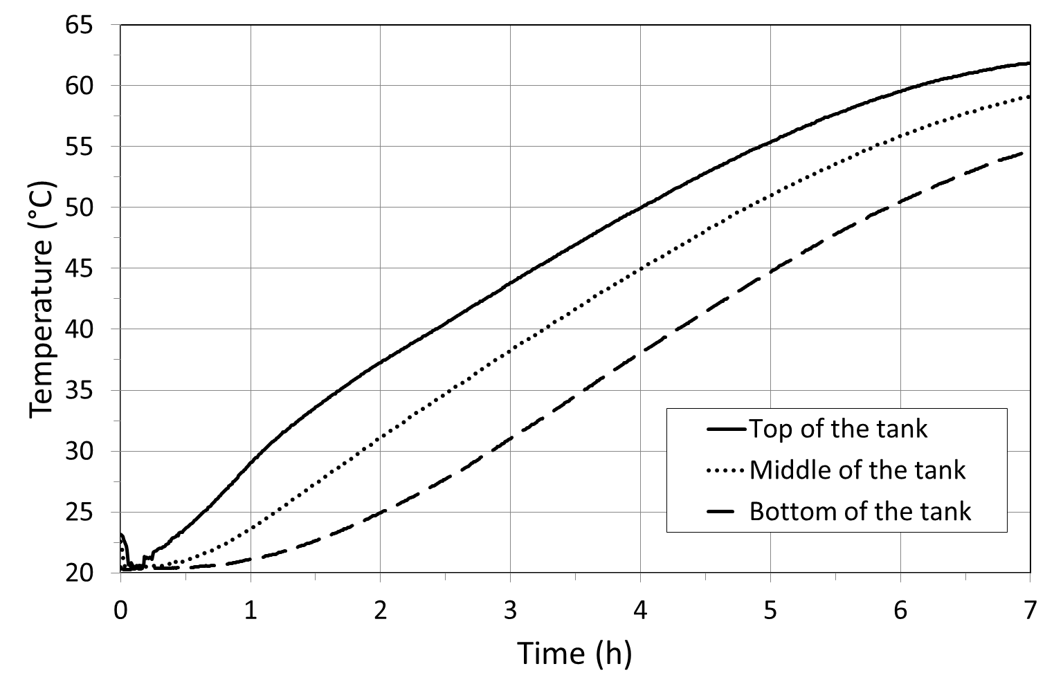
Solar Technologies
1. Non-concentrated Solar Technologies
1.1. Solar Thermal
1.1.2. SDHW Systems: Thermosiphon System
ΔT = 10 K
Dr. Nicolas CALVET

Slide 31
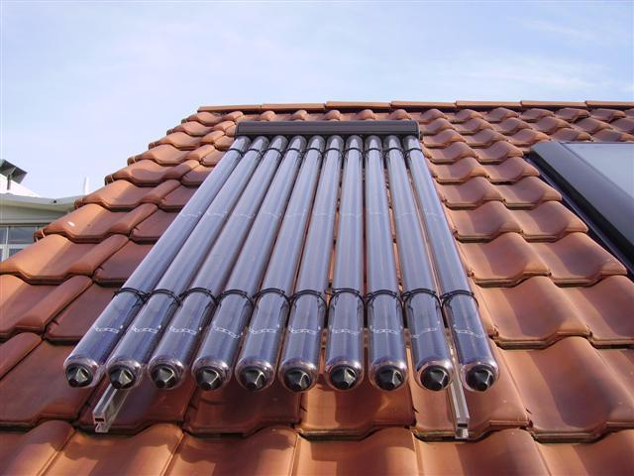
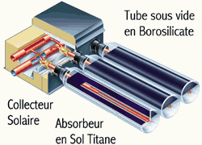
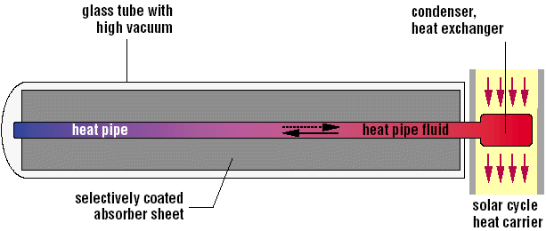
1. Non-concentrated Solar Technologies
Solar Technologies
1.1. Solar Thermal
1.1.3. SDHW Systems: Evacuated Tube Collectors
Dr. Nicolas CALVET

Slide 32
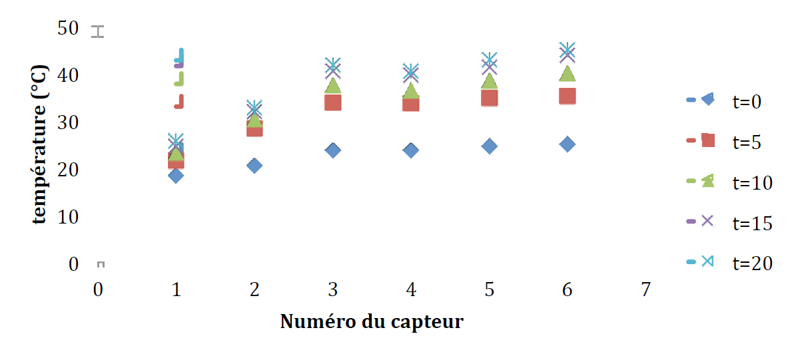
1. Non-concentrated Solar Technologies
Solar Technologies
1.1. Solar Thermal
1.1.3. Solar Air Panels
ΔT=20 K
Source: Dr. Régis Olivès
Dr. Nicolas CALVET

Slide 33
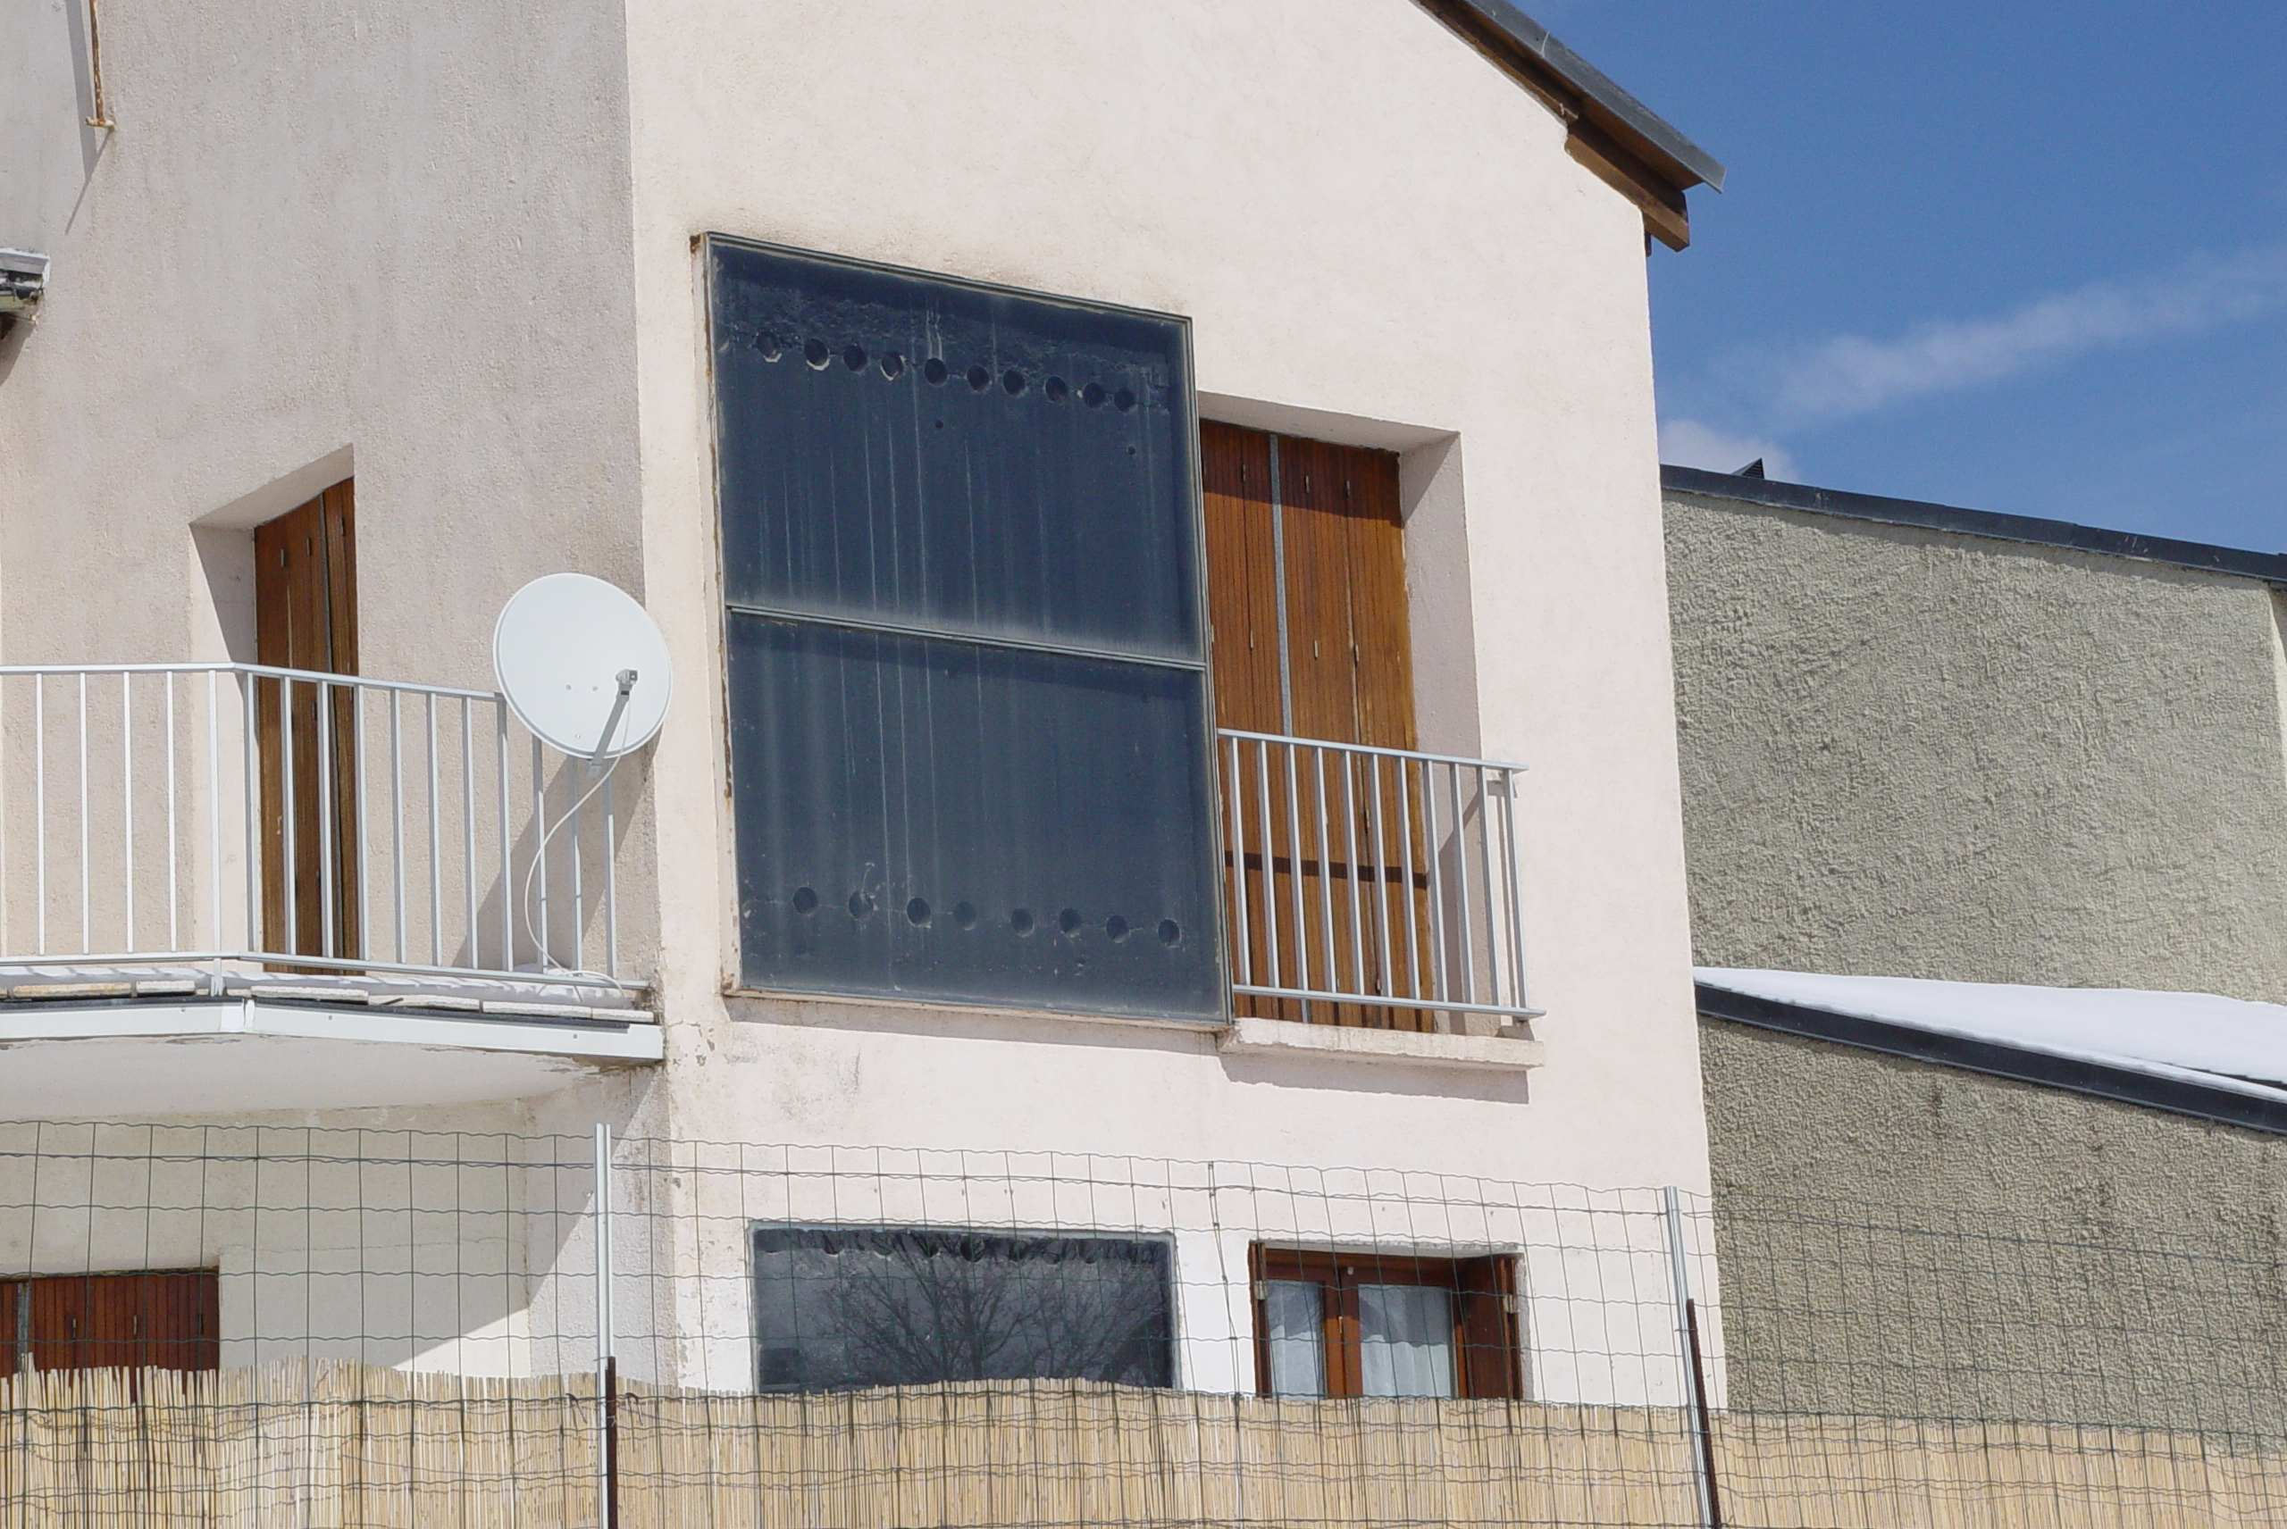
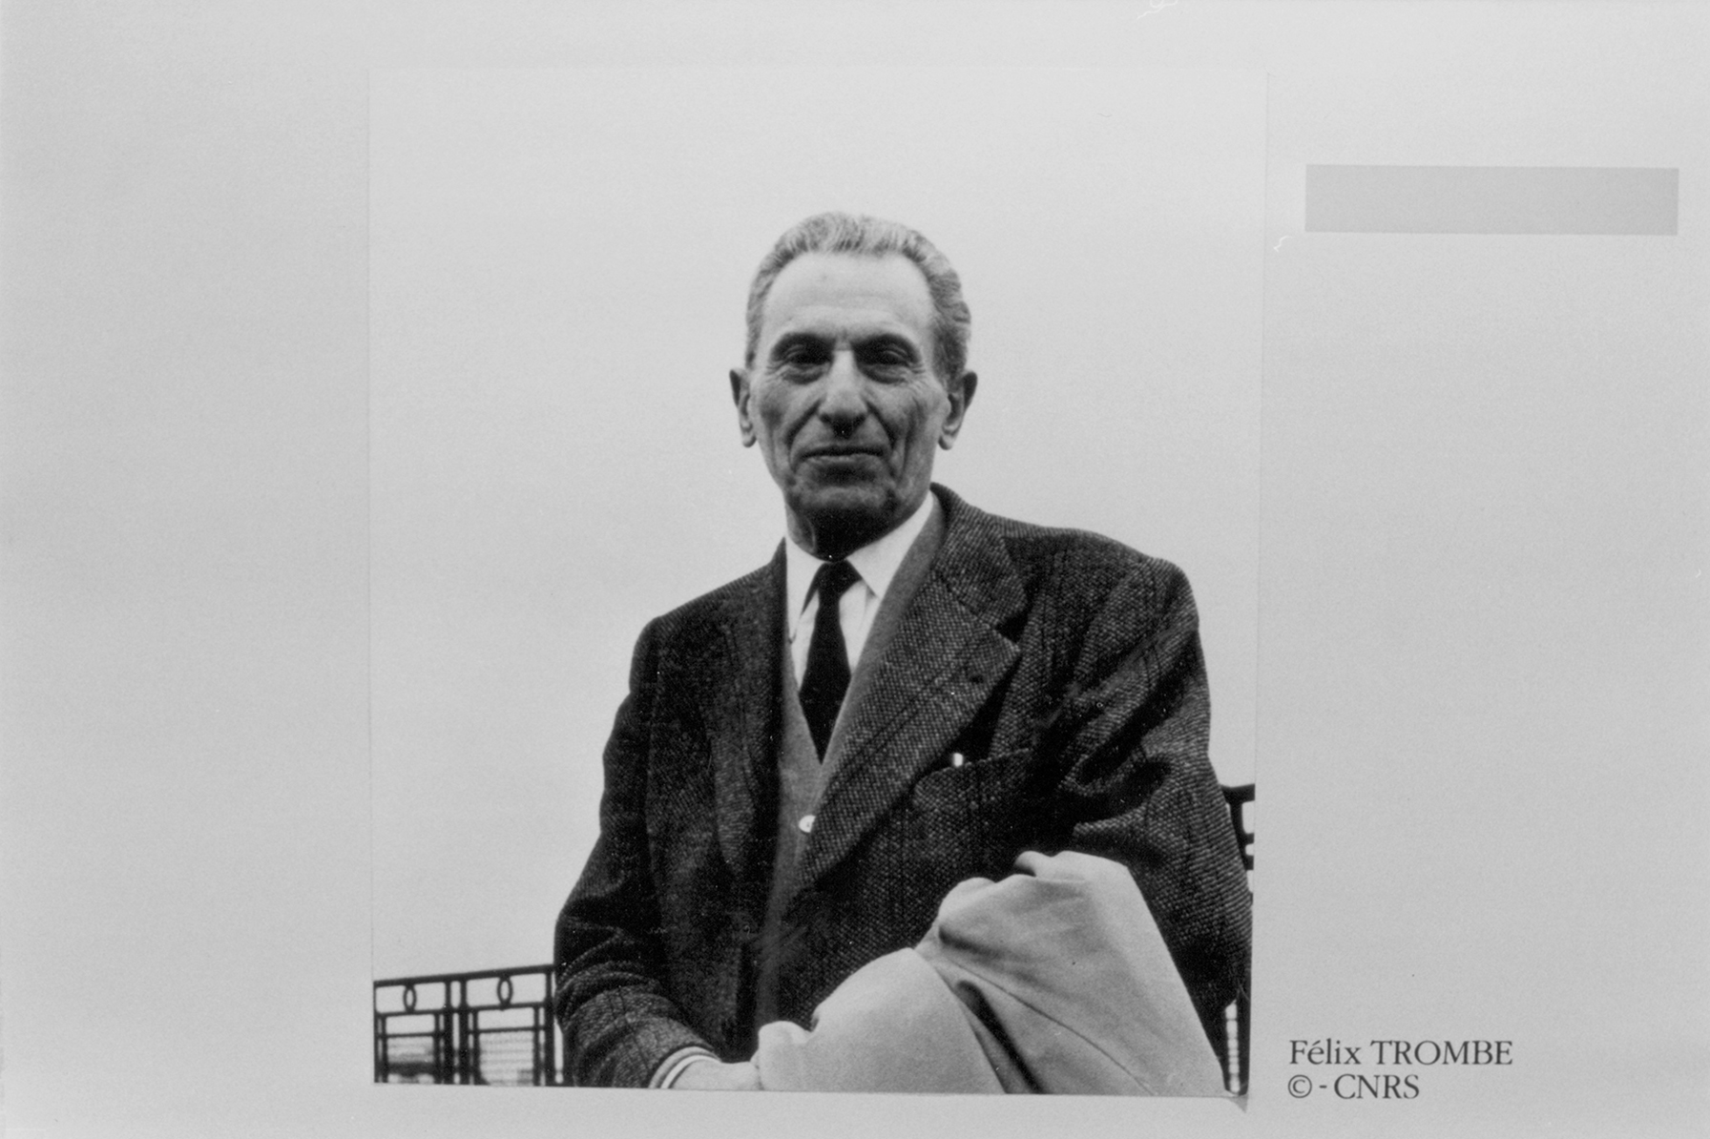
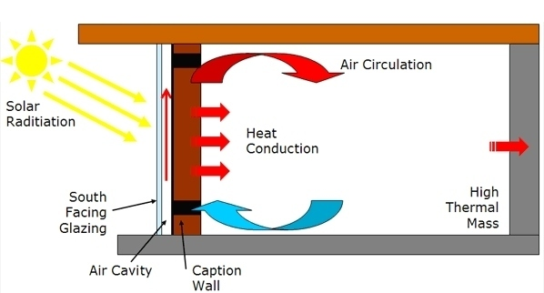

1. Non-concentrated Solar Technologies
Solar Technologies
1.1. Solar Thermal
1.1.4. Trombe Wall
Felix Trombe (1906 – 1985)
Dr. Nicolas CALVET

Slide 34
Solar Technologies
1. Non-concentrated Solar Technologies
1.1. Solar Thermal
1.1.5. Solar Chimney
Source: Dr. O. Goebel
Dr. Nicolas CALVET

Slide 35

Solar Technologies
1. Non-concentrated Solar Technologies
1.1. Solar Thermal
1.1.5. Solar Chimney
Dr. Nicolas CALVET

Slide 36

1. Non-concentrated Solar Technologies
Solar Technologies
1.1. Solar Thermal
1.1.6. Solar Cooling - Adsorption
Dr. Nicolas CALVET

Slide 37

1. Non-concentrated Solar Technologies
Solar Technologies
1.1. Solar Thermal
1.1.6. Solar Cooling - Absorption
Dr. Nicolas CALVET

Slide 38
Concentrated Technologies
Solar Technologies
Dr. Nicolas CALVET

Slide 39

Solar Technologies
2. Concentrated Solar Technologies
2.0. Concentrated Photovoltaic (CPV)
Advantages | Drawbacks
High efficiency | Use only direct radiation
Smaller area for same courant | Heat dissipation necessary
 | Cost of concentration
 | Cost of tracking
Source: Dr. Alain Dollet
Dr. Nicolas CALVET

Slide 40




Solar Technologies
2. Concentrated Solar Technologies
2.1. Concentrated Solar Power (CSP)
50 < C < 90
200 °C < T < 500 °C
Parabolic trough
Linear Fresnel Reflector
Power tower
Parabolic Dish/Stirling
25 < C < 50
200 °C < T < 500 °C
600 < C < 1000
200 °C < T < 1000 °C
C < 3000
500 °C < T < 1500 °C
Dr. Nicolas CALVET
Notes:
INDICE DE CADA APARTADO

Slide 41



Solar Technologies
2. Concentrated Solar Technologies
2.1. Parabolic Trough
Most matured technology
50 to 100 MW (per unit)
SEGS plants, Mojave desert, USA, 354 MW_{el}
Dr. Nicolas CALVET

Slide 42

Solar Technologies
2. Concentrated Solar Technologies
2.1. Parabolic Trough – Shams 1
Source: Dr. O. Goebel
Dr. Nicolas CALVET

Slide 43







Solar Technologies
2. Concentrated Solar Technologies
2.1. Parabolic Trough – Shams 1
Shams 1, 100 MW_{e},
Abu Dhabi
2.5 km² = 285 football fields
20,000 homes,
175,000 tons of CO2
Dr. Nicolas CALVET

Slide 44

Solar Technologies
2. Concentrated Solar Technologies
2.1. Parabolic Trough – Shams 1
Source: Dr. O. Goebel
Dr. Nicolas CALVET

Slide 45


Solar Technologies
2. Concentrated Solar Technologies
2.1. Parabolic Trough – New concept from Airlight Energy
HTF: air (570 C)
Source: Guglielmo Cioni
Dr. Nicolas CALVET

Slide 46


Solar Technologies
2. Concentrated Solar Technologies
2.2. Linear Fresnel Reflector (LFR)
Puerto Errado 2 (PE2), Murcia, Spain, 2012, 30 MW_{el}
Recent technology 10 to 30 MW (per unit)
Dr. Nicolas CALVET

Slide 47


Solar Technologies
2. Concentrated Solar Technologies
2.2. Linear Fresnel Reflector (LFR)
Dr. Nicolas CALVET

Slide 48



2. Concentrated Solar Technologies
2.3. Power Tower (or Central Receiver) - Molten salt receiver
Central receiver
THEMIS, Targasone, France
(2.5 MW_{e,} 1983 – 1986)
Heliostats
1.5 to 20 MW (per unit)
SOLAR 2, Mojave desert, CA, USA
(12.4 MW_{e},1995-1999)
Dr. Nicolas CALVET

Slide 49


Solar Technologies
2. Concentrated Solar Technologies
2.3. Power Tower (or Central Receiver) - Molten salt receiver
GEMASOLAR, Seville Spain 2011 - now
First commercial Power Tower
19.9 MW, 15 h TES
25,000 homes
Source: Juan Ignacio Burgaleta
(director of Sener)
Dr. Nicolas CALVET

Slide 50



Solar Technologies
2. Concentrated Solar Technologies
2.3. Power Tower (or Central Receiver) – Volumetric-air receiver
(in 2011)
Jüllich Power Tower, Germany (2008)
1.5 MW
HTF: Air (120 - 680 C)
Dr. Nicolas CALVET

Slide 51



Solar Technologies
2. Concentrated Solar Technologies
2.3. Power Tower (or Central Receiver) – Direct Steam Generation (DSG)
HTF: Water
PS10 & PS20, Seville, Spain, 11 & 20 MW_{e}
Dr. Nicolas CALVET

Slide 52



Solar Technologies
2. Concentrated Solar Technologies
2.3. Parabolic Dish Stirling
Low power (<400 kW per unit)
PROMES-CNRS, Odeillo, France, 10 kW_{el}
Dr. Nicolas CALVET

Slide 53





2. Concentrated Solar Technologies
Solar Technologies
2.2. Double Reflection Systems – 1 MW Solar Furnace
Odeillo, France
Dr. Nicolas CALVET

Slide 54








Solar Technologies
Pyrometer
Solar flux (W/m²)
T_{surface}
Carbon blades
Temperature controller

Slide 55



2. Concentrated Solar Technologies
Solar Technologies
2.2. Double Reflection Systems
Cofalit® ceramic sample
(L = 200 mm, D= 25 mm)
Tests of fatigue
Under repeated thermal stress
500 – 1000°C - under atm air
1000 – 2500°C/min
Dr. Nicolas CALVET

Slide 56


2. Concentrated Solar Technologies
Solar Technologies
2.2. Double Reflection Systems – Beam down
100 kW_{th}
Dr. Nicolas CALVET

Slide 57

Thank You
ncalvet@masdar.ac.ae
Dr. Nicolas CALVET
Version 1

